Slide 1
Power and Data Connections
Power in (gnd)
GND
Heltec
Power in (5V)
Pin (5V)
UART RX Pin 18
UART TX Pin 17
GND Pin 8
Honeywell Sensor
Pins are numbered right to left!!
UART RX Pin 7
UART TX Pin 6
Pin (5V)

Slide 2
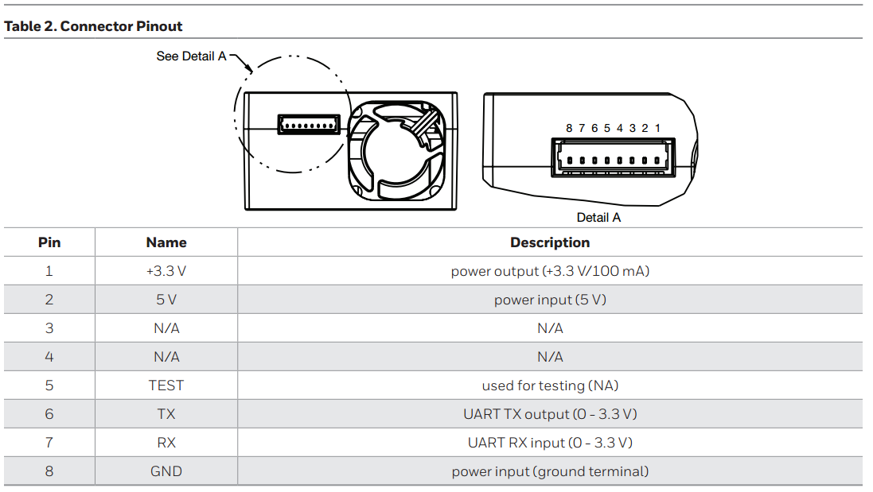
Honeywell HPMA Sensor Pinout

Slide 3
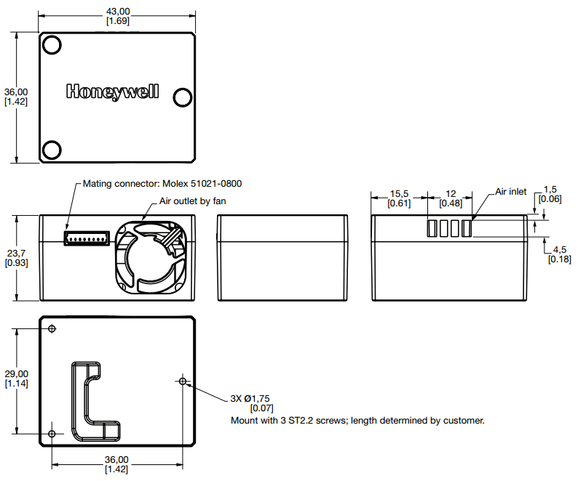
Honeywell HPMA Sensor Dimensions

Slide 4
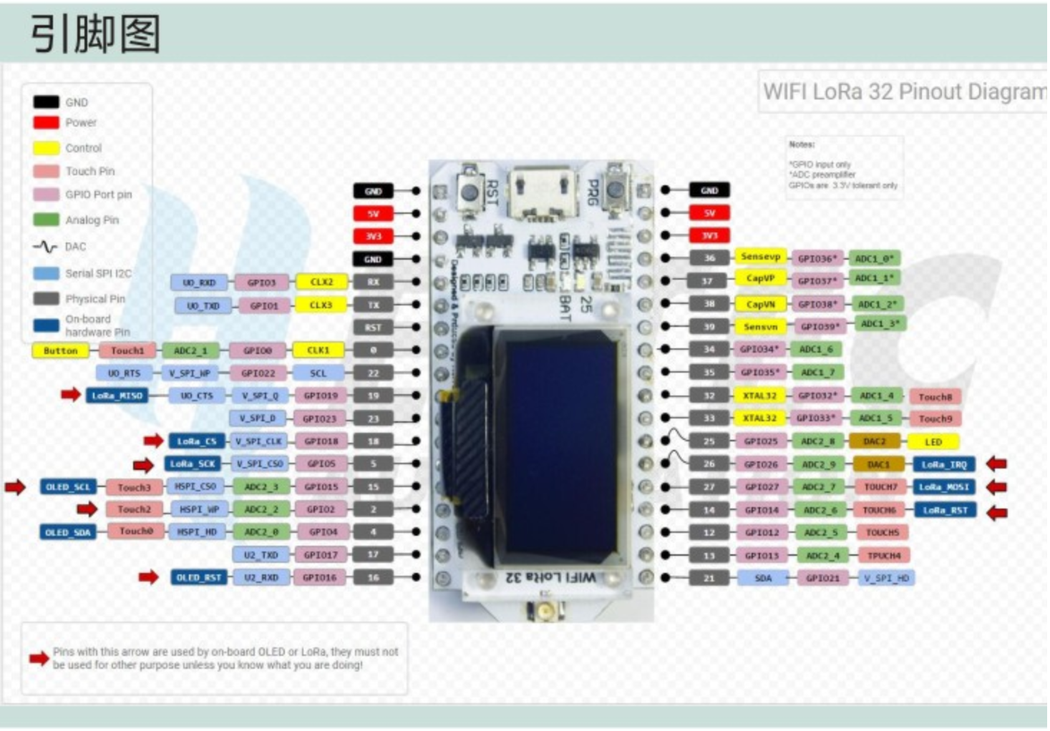
Heltec ESP32 Pinout

Slide 5
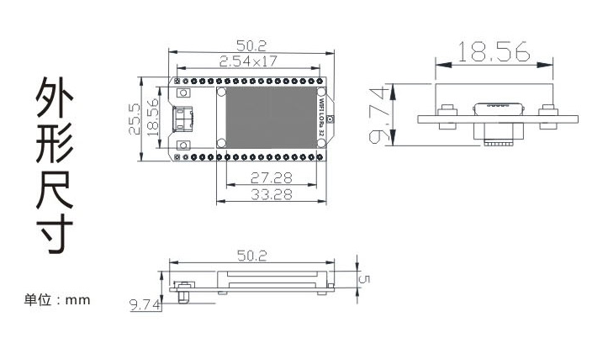
Heltec ESP32 Dimensions

